Slide 1


Giancarlo Malugani
May 17, 2022

Slide 2

Outline
Executive Summary
Introduction
Methodology
Results
Conclusion
Appendix

Slide 3
Executive Summary
Summary of methodologies
Summary of all results

Slide 4
Introduction
Project background and context
We will assume the role of a Data Scientist working for a startup intending to compete with SpaceX, and in the process follow the Data Science methodology involving data collection, data wrangling, exploratory data analysis, data visualization, model development, model evaluation, and reporting your results to stakeholders.
We will predict if the first stage of the SpaceX Falcon 9 rocket will land successfully. SpaceX advertises Falcon 9 rocket launches on its website, with a cost of 62 million dollars; other providers cost upward of 165 million dollars each, much of the savings is because SpaceX can reuse the first stage.
Problems you want to find answers
If we can accurately predict the likelihood of the first stage rocket landing successfully, we can determine the cost of a launch. With the help of our Data Science findings and models, the competing startup we have been hired by can make more informed bids against SpaceX for a rocket launch.
Project Repository
https://github.com/monkodev/DataScience_Final

Slide 5

Section 1

Slide 6
Methodology
Executive Summary
Data collection methodology:
The data was collected using SpaceX API (link shown in subsequent slides) & using webscraping technique from de web of Wikipedia
Perform data wrangling
With data collected, we process of cleaning and unifying messy and complex data sets for easy access and analysis
Perform exploratory data analysis (EDA) using visualization and SQL
Perform interactive visual analytics using Folium and Plotly Dash
Perform predictive analysis using classification models

Slide 7
Data Collection
Data sets were collected using two of the most used methods in data science: Webscraping of web pages and connections through SpaceX API REST to obtain a JSON file.
WebScraping
We collect data from Wikipedia URL
Extract a Falcon 9 launch records HTML table using BeautifulSoup
Parse the table and convert it into a Pandas data frame
API Request
We will make a get request to the SpaceX API (link)
Clean the requested data. Check & Fill missing values

Slide 8
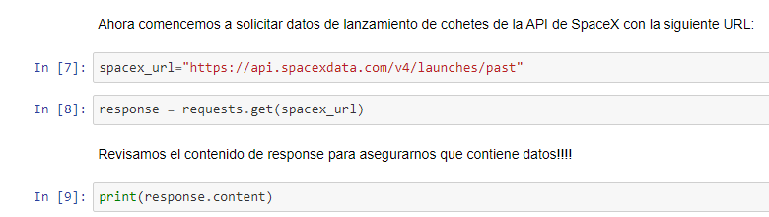
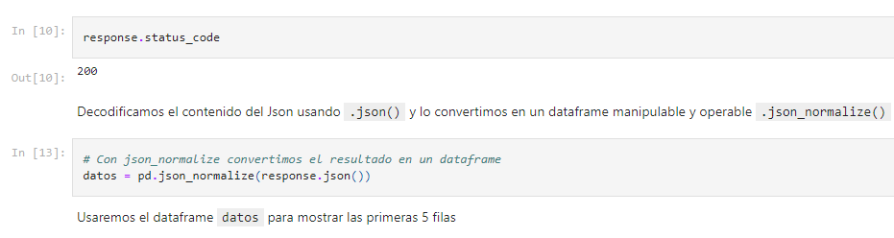
Data Collection – SpaceX API
Calls to SpaceX API REST to collect data.
Access Github Repo here: (Note: This notebook are in Spanish LANG): https://github.com/monkodev/DataScience_Final/blob/main/Jupyter%20Lab%20Api%20SpaceX.ipynb
View my Jupiter Notebook from IBM Watson (click here)

Slide 9
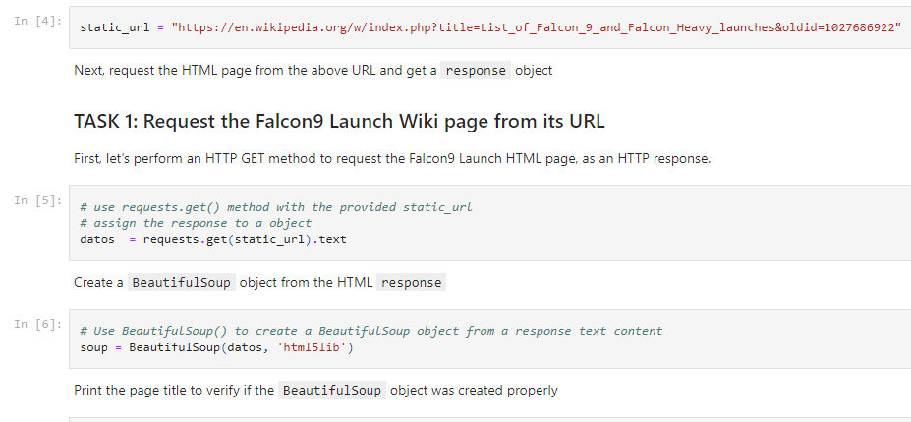
Data Collection - Scraping
Web Scrap Falcon 9 launch records with BeautifulSoup
Extract a Falcon9 launch records HTML table from WIKI
Parse the table & convert it into a Pandas DataFrame
Github Repo: https://github.com/monkodev/DataScience_Final/blob/main/TP%20Final%20con%20Web%20Scrapping%20.ipynb

Slide 10
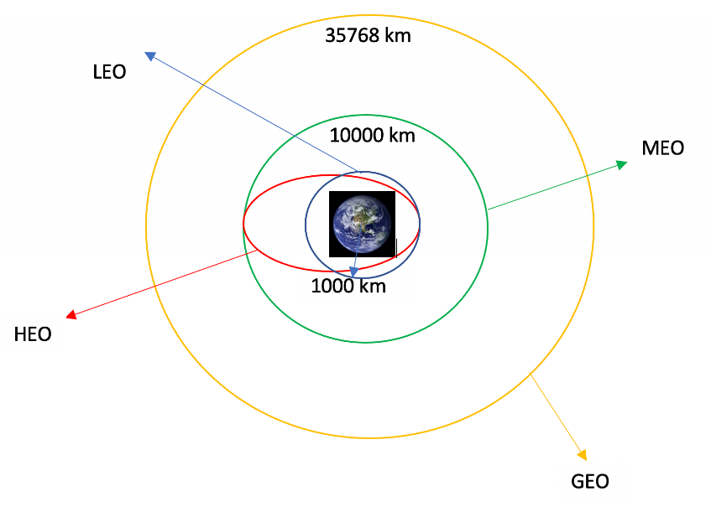
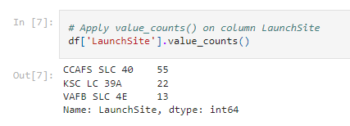
Data Wrangling
Basically, the purpose of this work we had convert those outcomes into Training Labels with 1 means the booster successfully landed 0 means it was unsuccessful
We calculated the number of launches at each site and the number and occurrence of each orbits and other info. Finally we exported the results to csv file & save them in Github project Repo (view this file)
View complete notebook on Github: https://github.com/monkodev/DataScience_Final/blob/main/SpaceX%20Data%20Wrangling.ipynb

Slide 11
EDA with SQL
In this notebook the work is to understand the SpaceX dataset and then load it into a table in Db2 database
When data is loaded into database we execute some queries to answer and present important information. For example:
Display names of the unique launch sites in the space mission
Display 5 records where launch sites begin with the string 'CCA‘
Total payload mass carried by boosters launched by NASA (CRS)
Average payload mass carried by booster version F9 v1.1
List the failed landing_outcomes in drone ship, their booster versions, and launch site names for in year 2015
……. + 5 others SQL queries with important information
Link to the notebook is: https://github.com/monkodev/DataScience_Final/blob/main/EDA%20with%20SQL.ipynb

Slide 12
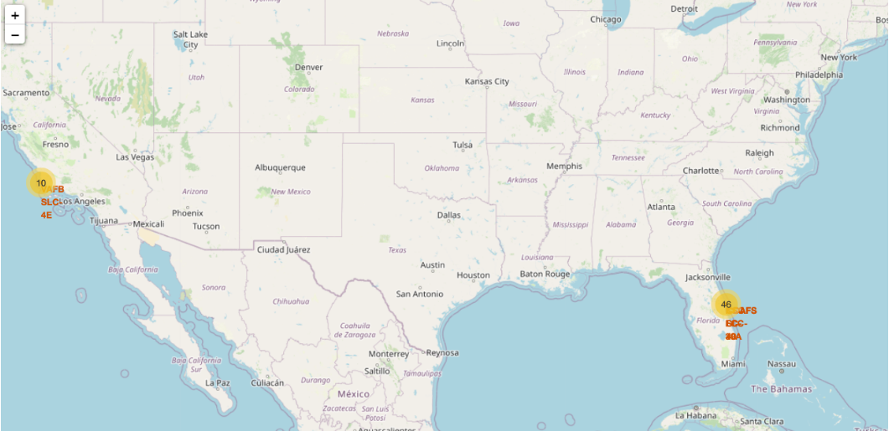
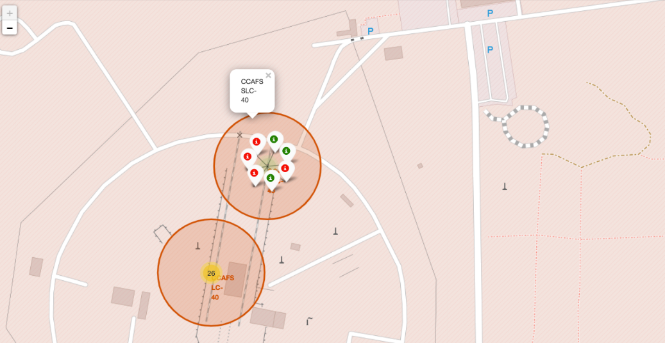
Build an Interactive Map with Folium
With Folium library we added a map into a notebook and mark some facts (with circles, markers or lines) to discover important data such as:
All launch sites on a map
The success/failed launches for each site on the map
Calculate the distances between a launch site to its proximities
Link to GitHub Repo: https://github.com/monkodev/DataScience_Final/blob/main/Analisis%20interactivo%20con%20Folium.ipynb

Slide 13
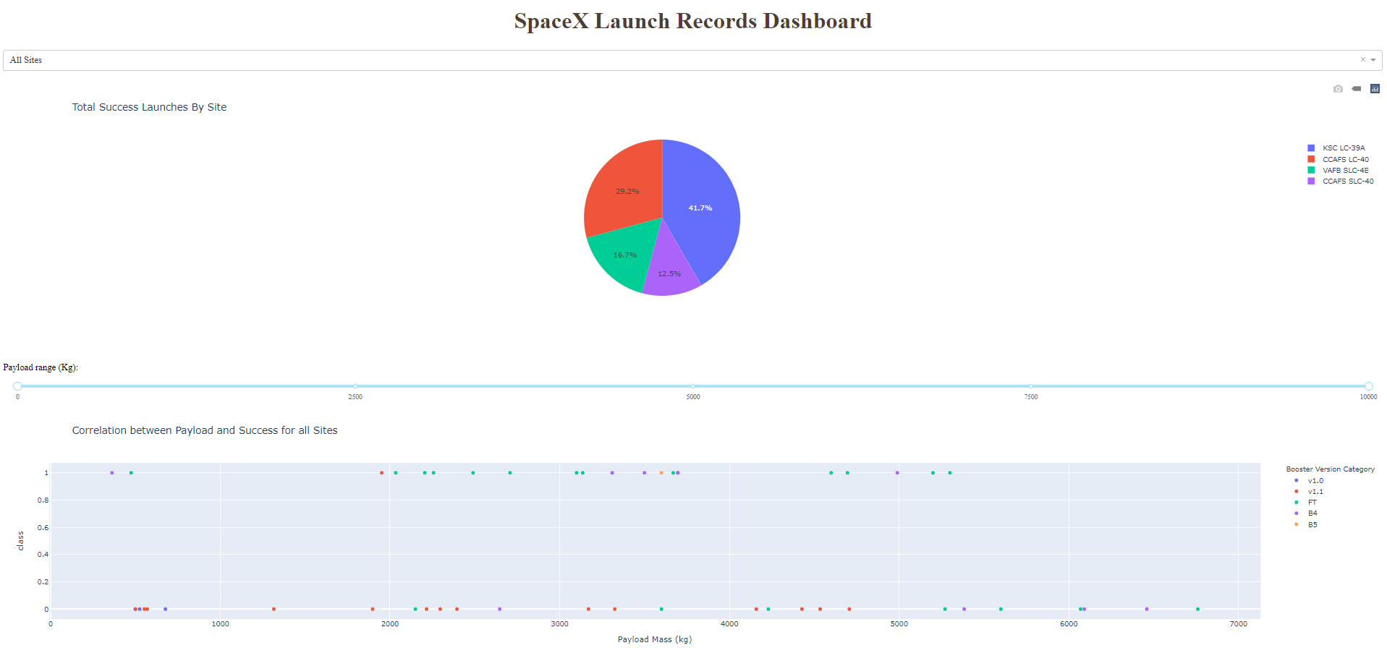
Build a Dashboard with Plotly Dash
We Built a real-time dashboard for users to perform and analyze launch records interactively with Plotly Dash.
Pie chart showing the total launches by a certain sites
Scatter graph showing the relationship with Outcome and Payload Mass (Kg) for the different booster version
View python code: https://github.com/monkodev/DataScience_Final/blob/main/spacex_dash_app.py

Slide 14
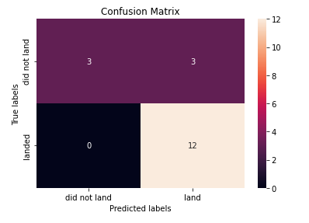
Predictive Analysis (Classification)
Perform exploratory Data Analysis and determine Training Labels
create a column for the class
Standardize the data
Split into training data and test data
Find best Hyperparameter for SVM, Classification Trees and Logistic Regression
Find the method performs best using test data
Link to notebook: https://github.com/monkodev/DataScience_Final/blob/main/ML%20Lab%20Malugani.ipynb

Slide 15
Results
Exploratory data analysis results
Interactive analytics demo in screenshots
Predictive analysis results

Slide 16

Section 2

Slide 17
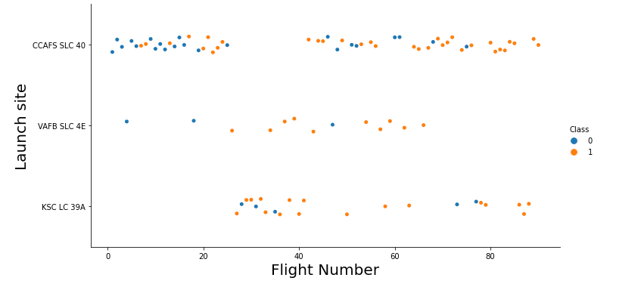

Flight Number vs. Launch Site
With the graph that visualize we can conclude that the greater the amount of flight in a launch site; the higher the success rate of that site

Slide 18
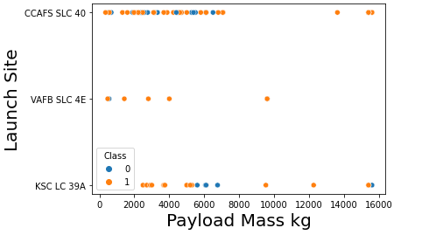

Payload vs. Launch Site
We find the VAFB-SLC launchsite there are no rockets launched for heavy payload mass(greater than 10000)
In CCAFS rocket for greater mass; the greater the probability of success in the launch

Slide 19
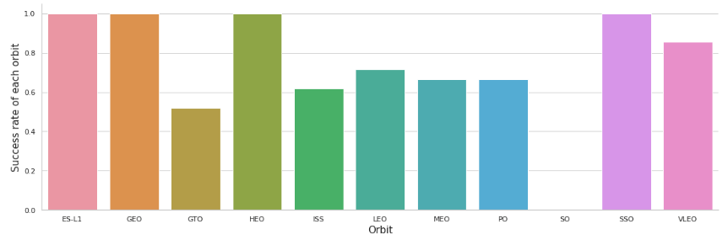
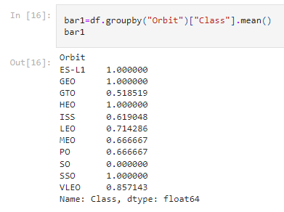
Success Rate vs. Orbit Type
As you can see in the graph in the code that we show you, the orbits ES-L1, GEO, HEO, SSO, VLEO
are the ones with the highest success rates in SpaceX space missions

Slide 20
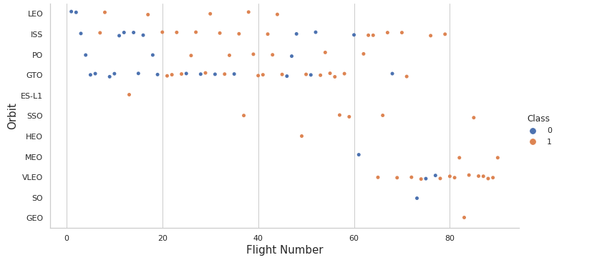
Flight Number vs. Orbit Type
We can see that in the LEO orbit the Success appears related to the number of flights; on the other hand, there seems to be no relationship between flight number when in GTO orbit

Slide 21
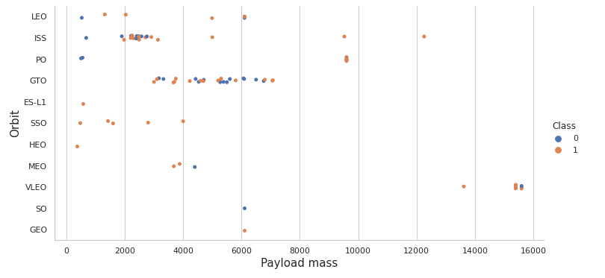
Payload vs. Orbit Type
We can observe that with heavy payloads, the successful landing are more for PO, LEO and ISS orbits.

Slide 22
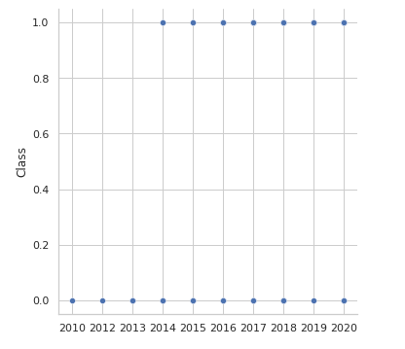

Launch Success Yearly Trend
We can observe that the sucess rate since 2013 kept increasing till 2020

Slide 23
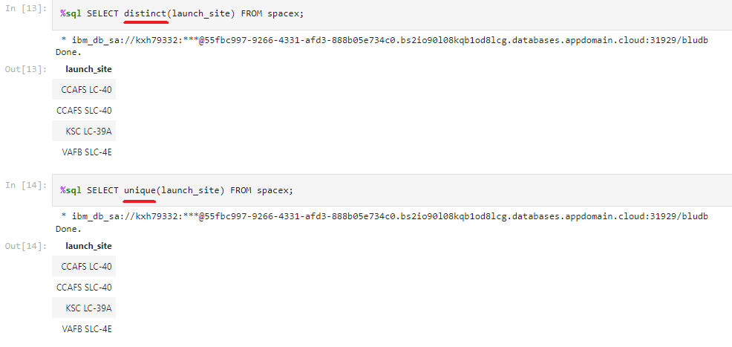
All Launch Site Names
We can use unique statement as well as distinct to show the different launch site names

Slide 24
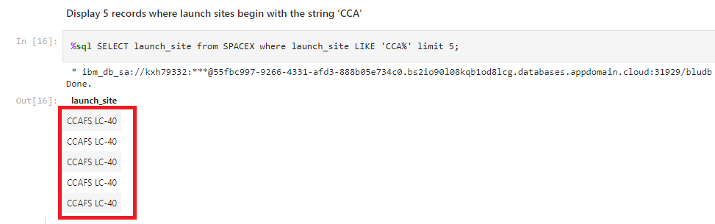
Launch Site Names Begin with 'CCA'
We show the 5 launch sites with the limit statement. To tell sql to look for the string 'CCA' we do it with like statement

Slide 25
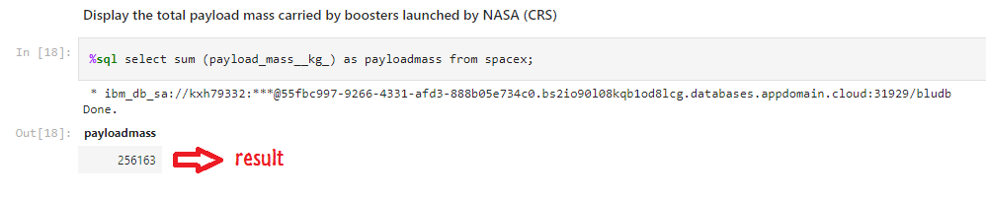
Total Payload Mass
The total payload carried by boosters from NASA are 156.163 kg
We use sum statement to add all the rows of the fields “payload_mass__kg_”

Slide 26
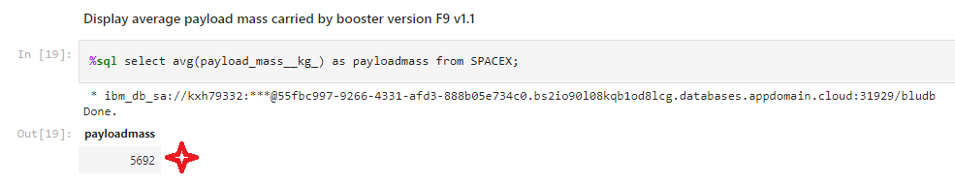
Average Payload Mass by F9 v1.1
The AVG() function returns the average value of an expression. In this case display the average value of all records of payload_mass

Slide 27
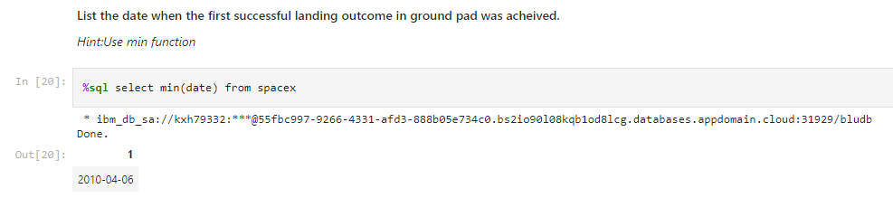
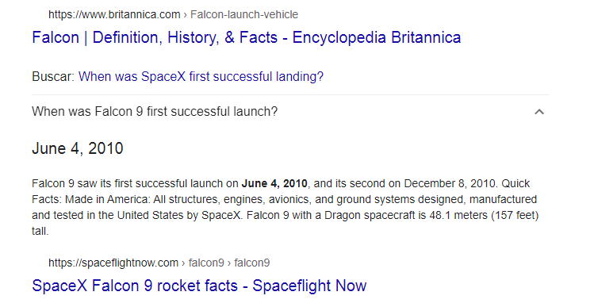
First Successful Ground Landing Date
We validate the result of the sql
query searching in google!
https://spaceflightnow.com/falcon9/004/falcon9.html

Slide 28
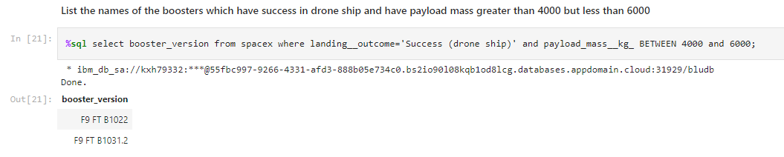
Successful Drone Ship Landing with Payload between 4000 and 6000
We used the where clause to filter for boosters which have successfully landed on drone ship and applied the and condition to determine successful landing with payload mass greater than 4000 but less than 6000

Slide 29
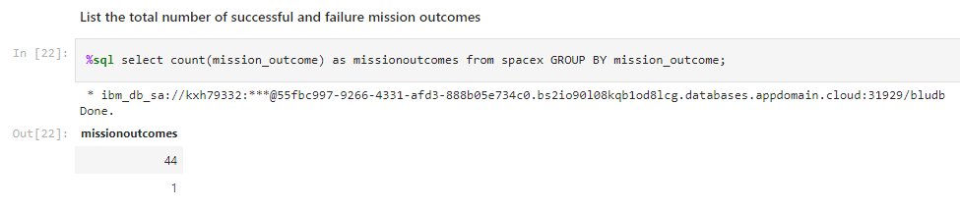
Total Number of Successful and Failure Mission Outcomes
We count the number of failed records with the count() clause.
We must necessarily use the group by to indicate the index field

Slide 30
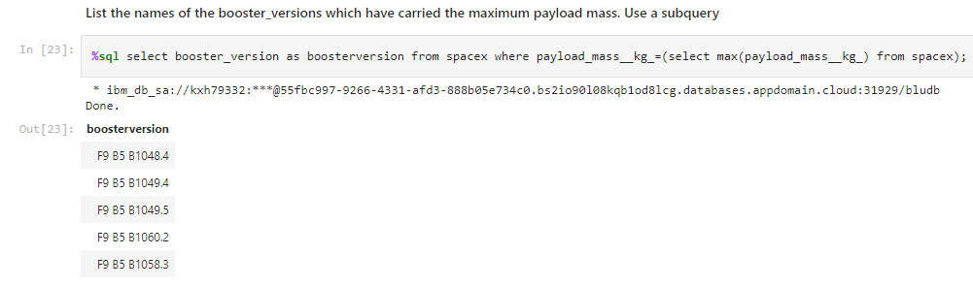
Boosters Carried Maximum Payload
Using subqueries we show the versions of the boosters that had the maximum weight recorded. We use max() clause.

Slide 31
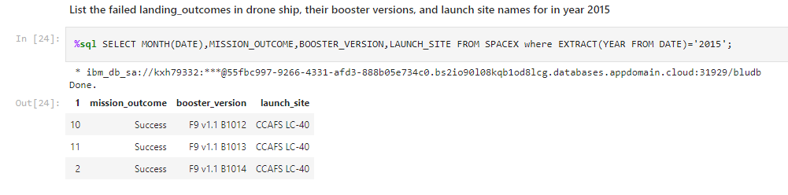
2015 Launch Records
The month() function returns the month of a date datetime() .
In the same way "extract (year from date)" informs us of the year to compare
it with our searched year = 2015

Slide 32
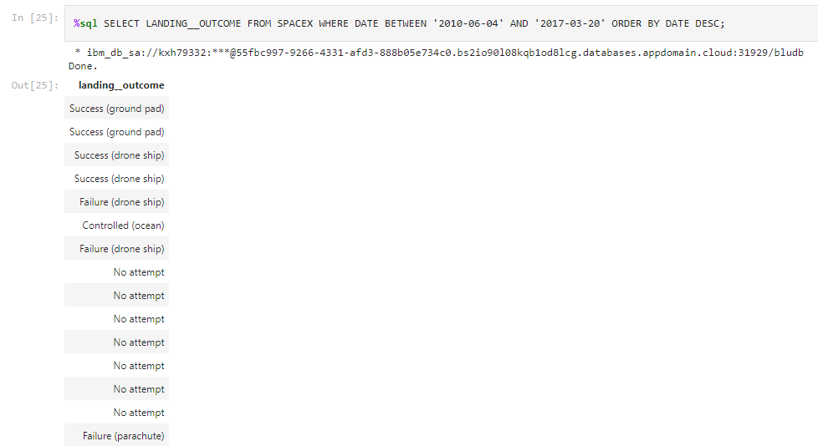
Rank Landing Outcomes Between 2010-06-04 and 2017-03-20
Rank the count of landing outcomes (such as Failure (drone ship) or Success (ground pad)) between the date 2010-06-04 and 2017-03-20, in descending order
Select the landing oucomes and we use the where clause to filter dates.
Using between clause we can select records into two dates range.

Slide 33

Section 3

Slide 34
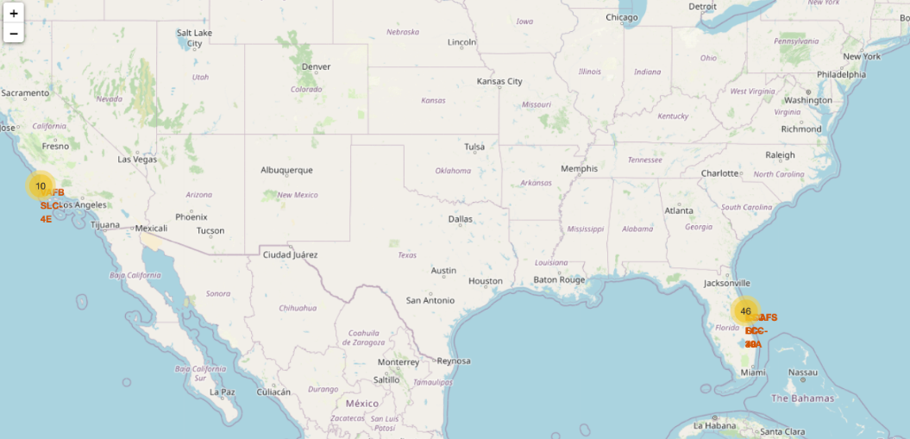
North America Launch Map
We see on the map that SpaceX launches have been in the states of Florida and California

Slide 35

Florida Launch Site
Successful launches are represented in green and failed launches in red.

Slide 36

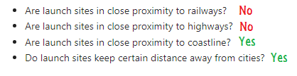
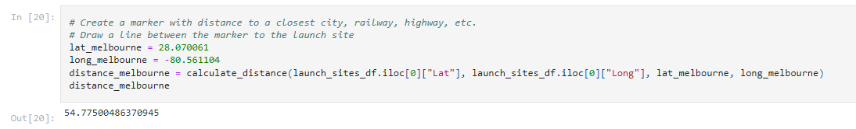
Proximities to launch sites
Distance to coastline
We calculate distance to Melbourne - Australia

Slide 37

Section 4

Slide 38
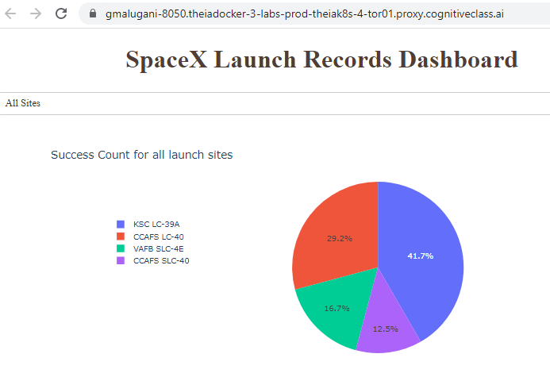
Total Success Launches by all sites
Almost half of the launches were
made from KSCLC (42%)

Slide 39
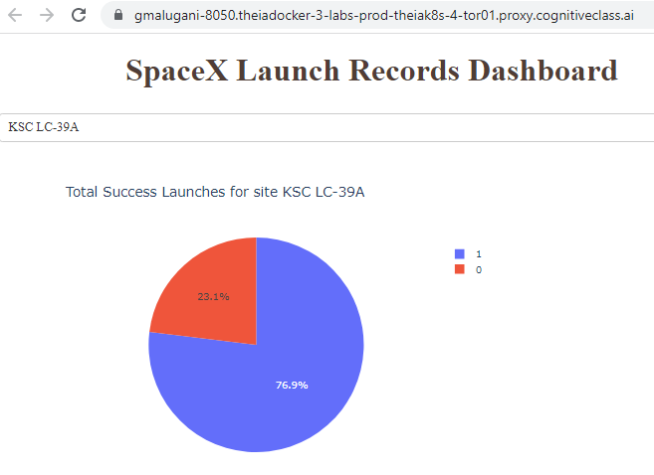
Site with highest probability of success
Site KSC LC-39 A have 77% of success in each launch

Slide 40
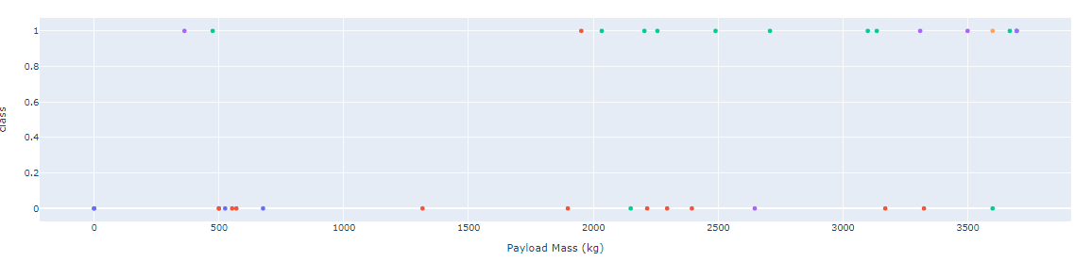
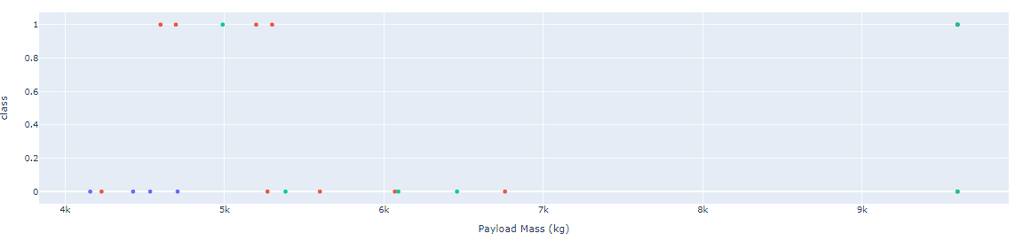
With lighter loads there is a greater probability of success
Comparision of loads
Low Loads (range: 0-4000 kg)
High Loads (range: 4000-10000 kg)

Slide 41

Section 5

Slide 42
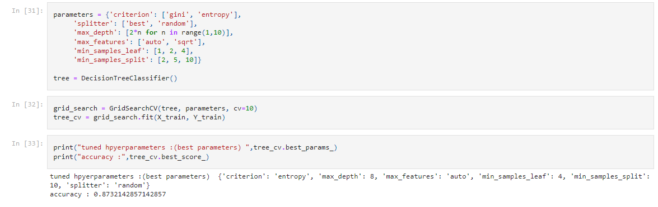
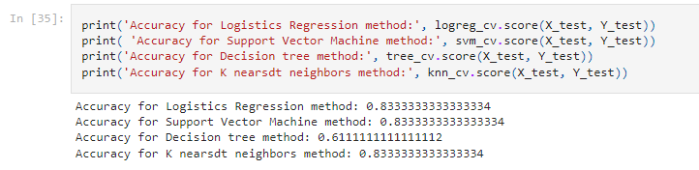
Classification Accuracy
The decision tree classifier is the model with the highest classification accuracy

Slide 43
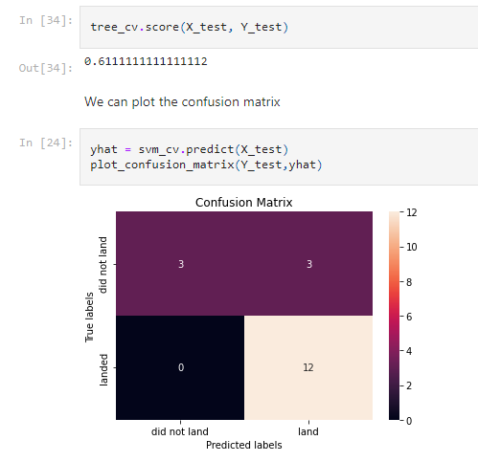
Confusion Matrix
The confusion matrix for the decision tree classifier shows that the classifier can distinguish between the different clases.

Slide 44

Conclusions
The higher the number of launches on a launch site, the higher the success rate on a launch site
The launch success rate started to increase from 2014
ES-L1, GEO, HEO, SSO, VLEO orbits had the highest success rate
KSC LC-39A had the most successful launches of all sites
Decision tree classifier is the best machine learning algorithm for this research

Slide 45
Appendix
To solve all the labs it was extremely necessary to consult the IT bible : Stackoverflow (www.stackoverflow.com)
Learn here Pandas Tutorial (https://www.w3schools.com/python/pandas/default.asp)
https://spaceflightnow.com/falcon9/004/falcon9.html
https://docs.spacexdata.com/

Slide 46


